Slide 1
A Conformal Martingales Ensemble Approach for Addressing Concept Drift
Eliades Charalambos, Harris Papadopoulos

Slide 2
Outline
Motivation
Concept drift
Inductive Conformal Martingales
Betting Functions
Ensemble ICM
Experiments and Results
Conclusions and Feature Work

Slide 3
Motivation
Prior Work: Used a single ICM for fast, efficient CD detection.
Challenges: Single models can give false or missed alarms.
Goal: Boost accuracy in the CD problem.
Why Ensemble?: To combine the strengths of multiple models for a robust solution.

Slide 4
Concept Drift
Occurs when the underlying data distribution changes over time.
i.e $P_{t}(X,Y)≠P_{t+1}(X,Y)$
$P_{t+1}\left(X,Y\right)=$ $P_{t+1}\left(X|Y\right)$. $P_{t+1}\left(Y\right)$ and $P_{t}\left(X,Y\right)=$ $P_{t}\left(X|Y\right)$. $P_{t}\left(Y\right)$
At least one of these conditions must be met $P_{t+1}\left(X|Y\right)$ $≠$ $P_{t}\left(X|Y\right)$, $P_{t+1}\left(Y\right)$ $≠$ $P_{t}\left(Y\right)$
Leads to inaccurate predictions.
Need for timely detection and model retraining.

Slide 5
Concept Drift
Concept drift categories
Sudden drift: Instantaneous change in data distribution
Gradual drift: Slow transition from one distribution to another.
Initial distribution fades, new one emerges.
Incremental drift: Incremental replacement of old by new
Reoccurring drift: Previous data distributions return.

Slide 6
Concept drift
Source: Learning under Concept Drift: A Review
Fellow, IEEE, Anjin Liu, Member, IEEE, Fan Dong, Feng Gu, Joao Gama, and Guangquan Zhang

Slide 7
Data Exchangeability
Exchangeability:
Given an infinite sequence of random variables $(Z_{1},Z_{2},Z_{3},…)$the joint distribution $P(Z_{1},Z_{2},Z_{3},…)$is exchangeable if it is invariant under any permutation of those random variables.
Testing if the data is exchangeable is equivalent to testing the data for being i.i.d
Test Exchangeability Martingale
Is a sequence of random variables $S_{1},S_{2},S_{3},…$ greater or equal to zero
They keep the conditional expectation $𝔼(S_{n+1}|S_{1},S_{2},S_{3},…S_{n}) =S_{n}.$

Slide 8
The Role of Martingales in Fair Gambling
Fair Game and Infinite Wealth Scenario
Martingale as a Measure of Gains
Ville's Inequality
$ℙ\left({∃n,S}_{n}≥C\right)≤1/C$

Slide 9
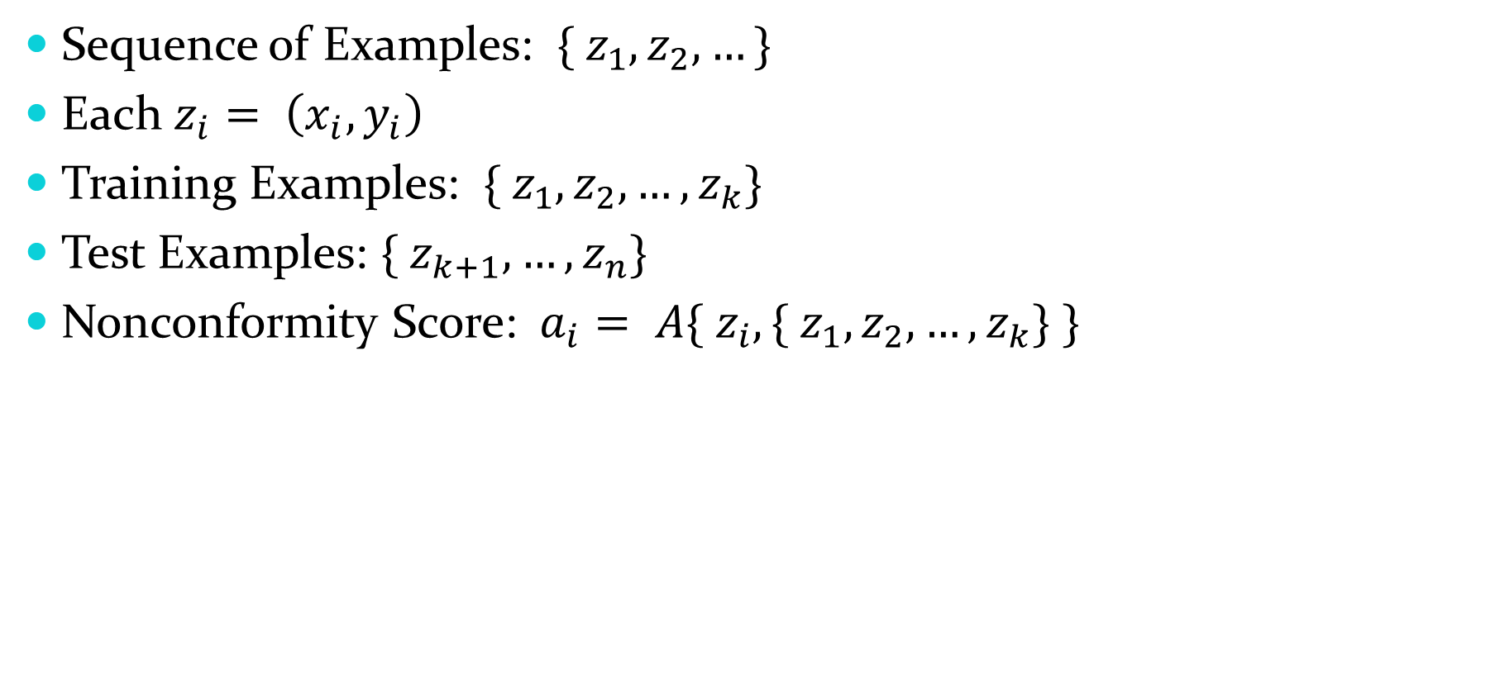
How to Calculate Non-conformity Scores
Sequence of Examples: $\{ z_{1}, z_{2}, …\}$
Each $z_{i}= \left(x_{i}, y_{i}\right)$
Training Examples: $\{ z_{1}, z_{2}, …, z_{k}\}$
Test Examples: $\{ z_{k+1}, …, z_{n}\}$
Nonconformity Score: $a_{i}= A\{ z_{i}, \{ z_{1}, z_{2}, …, z_{k}\} \}$

Slide 10
Nonconformity Measure
Underlying Algorithm
Treebagger Classifier
NCM
For each example $z_{j}$, Treebagger Classifier outputs $\tilde{p_{j} }$ (posterior probability).
Nonconformity Measure $a_{j}=−\tilde{p_{j} }$

Slide 11
P-value Calculation
To find the p-value of the example $z_{j}$ we use the sequence $H_{j}=\{a_{k+1},, …,a_{j}\}$
Formula
$p_{j}=\frac{\left|\left\{a_{i}∈H_{j} | a_{i}>a_{j}\right\}\right|+U_{j}|\left\{a_{i}∈H_{j} | a_{i}=a_{j}\right\}|}{j−k}$
$U_{j}$ is a random number from a uniform distribution (0,1).

Slide 12
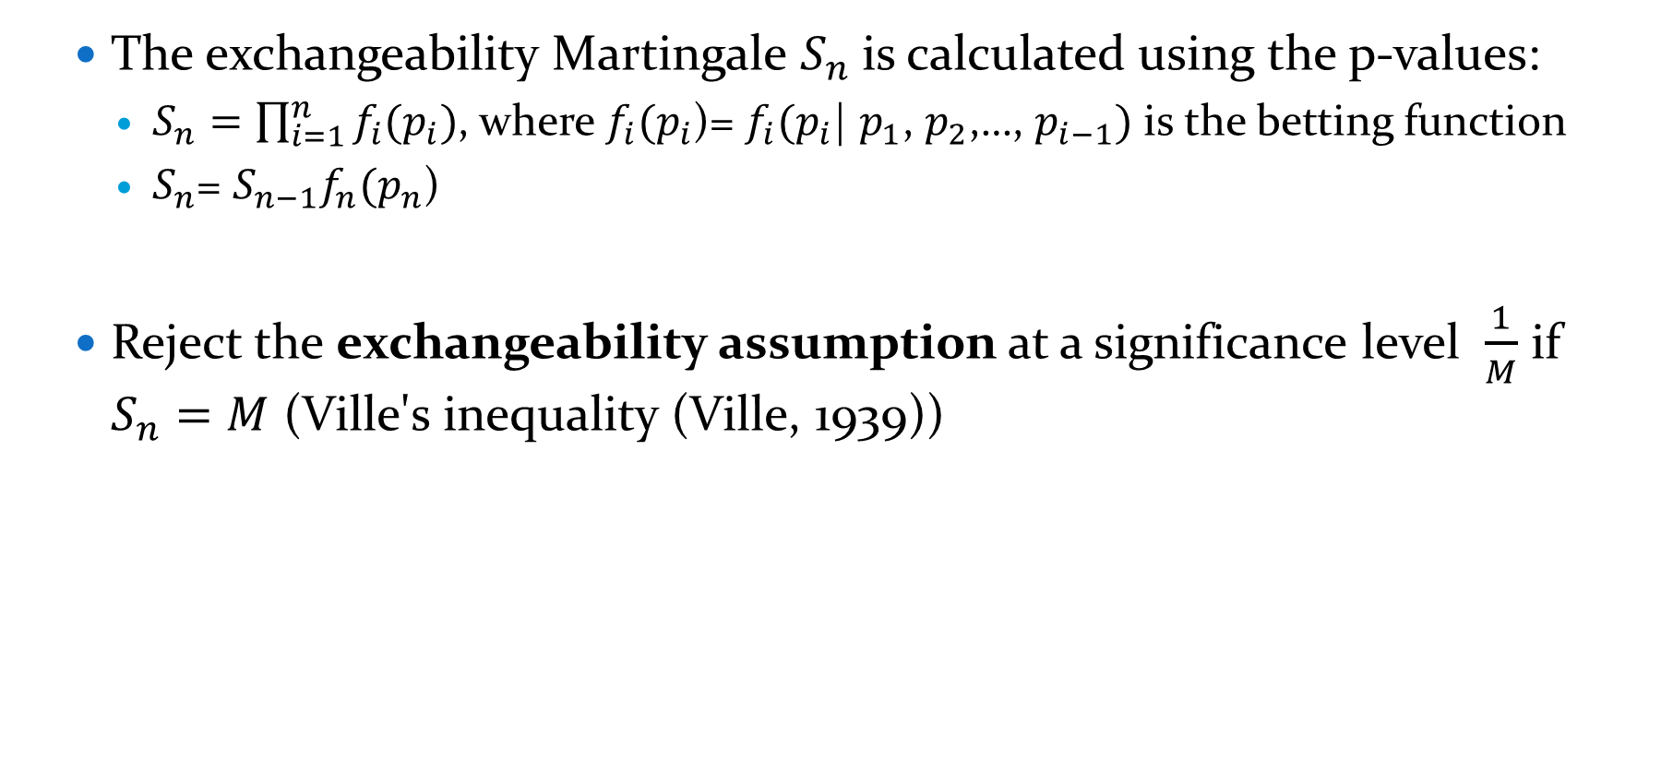
Conformal Martingales
The exchangeability Martingale $S_{n}$is calculated using the p-values:
$S_{n}=\prod_{i=1}^{n}{f_{i}(p_{i})}$, where $f_{i}(p_{i}$)= $f_{i}(p_{i}$| $p_{1}$, $p_{2}$,…, $p_{i−1})$ is the betting function
$S_{n}$= $S_{n−1}f_{n}(p_{n}\text{)}$
Reject the exchangeability assumption at a significance level $\frac{1}{M}$ if $S_{n}=M$ (Ville's inequality (Ville, 1939))

Slide 13
Histogram Estimator as a Betting Function
Our goal here is to calculate a density estimator$\hat{{ f}_{n}}$ of the density distribution of the p-value series, $p_{1}$, $p_{2}$,…, $p_{n−1}$
Histogram Estimator
We partition [0,1] into $κ$ bins: $B_{1}=[0,\frac{1}{κ})$, $B_{2}=[\frac{1}{κ},\frac{2}{κ})$,…, $B_{k}=[\frac{κ−1}{κ},1]$
Density estimator $\hat{f_{n}}\left(p_{n}\right)=\frac{n_{j}.κ}{n−1}$,
where $n_{j}$ is the number of p-values belonging to $B_{j}$

Slide 14
Kernel Estimator as a Betting Function
Kernel estimator
$\hat{f_{n}}\left(p_{n}\right)=\frac{1}{nh}\sum_{i=i}^{n}{K(\frac{p_{n}−p_{i}}{h})}$
Where K(z)=$\frac{1}{\sqrt{2π}}e^{−\frac{z^{2}}{2}}$
h is the bandwidth.

Slide 15

The Cautious Betting Function
Cautious Betting Function: $h_{n}$= $\left\{\begin{aligned}1 if\frac{{S1}_{n−1}}{min{S1}_{n−k}}≤ε \\ f_{n} if\frac{{S1}_{n−1}}{min{S1}_{n−k}}>ε\end{aligned}\right.$
${With S1}_{n−k}=\prod_{i=1}^{n}{f_{i}(p_{i})} ,ε>0 k∈\{n−w,…,n−1\}$ and w is an integer

Slide 16
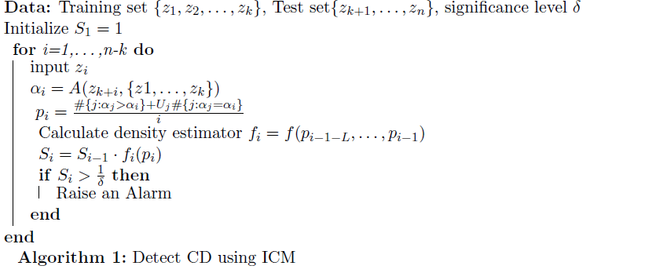
CD detection with ICM
Now if the final value of the Martingale $S_{i}$ exceeds 10 or 100 then we can reject the exchangeability assumption at a significance level equal to 10% and 1% respectively, thus an alarm is raised for CD detection.

Slide 17
Ensemble ICM for Concept Drift Detection
Enhancement over single classifier ICM for robust CD detection.
Parallel Classifiers: 10 classifiers trained with different instance sizes(k); each has its unique ICM.
Majority Voting: Final prediction based on the most frequent label across classifiers.
Adaptive Retraining: Only affected classifiers are updated, ensuring continuous prediction.
Remains consistent despite individual ICM missed or false alarms.

Slide 18
Ensemble ICM for Concept Drift Detection
1. Initialization: Prepares 10 classifiers with empty states.
2. Data Loop: Goes through each instance in the dataset.
3. Classifier Loop: Each classifier performs the following:
- If Updated: Makes predictions and checks for concept drift.
- If Drift Detected: that concept drift may have begun earlier than its detection. We look backward to the point where the Martingale value is at least r. If we don’t collect k instances we look forward to gather the remaining.
- If Ready to Retrain: Retrains on new data and resumes.
4. Final Prediction: Combines predictions from all classifiers.

Slide 19
Experiments and results - Datasets
1 simulation for the STAGGER case
30 simulations for the SEA,ELEC dataset
Dataset | Number of Instances | Number of Variables | Number of labels | Number of concepts | Chunk size
STAGGER | 1000000 | 3 categorical (3 values) | 2 | 4 | 10000
SEA | 1000000 | 3 numeric (ranging from 0 to 10) | 2 | 4 | 250000
ELEC | 45312 | 8 numeric | 2 | unknown | unknown
AIRLINES | 539383 | 7 numeric | 2 | unknown | unknown

Slide 20
Experiments and results – Experimental Setting
We have used 10 classifiers with varying training set sizes.(100,200,…,1000)
For algorithm 1 δ={0.01}
To calculate the histogram estimator we have used the p-values of the last 1000 observations.
To calculate the kernel estimator we have used the p-values of the last 100 observations.
For the Cautious betting function we have used a $W=5000$and $ε=100$
Martingale Threshold (r): {2, 10, 100}

Slide 21
Experiments and results
Performance measures
Accuracy: Reflects the average prediction accuracy of the ensemble classifier.
Instances with No Prediction (%): Indicates the percentage of instances where none of the classifiers in the ensemble offered a prediction, either because they were in the process of retraining or the instance was part of their training set.

Slide 22
Experiments and results

Slide 23
Experiments and results

Slide 24
Experiments and results

Slide 25
Experiments and results

Slide 26
Experiments and results

Slide 27
Conclusions
1. Our Approach: ICM Ensemble for the Concept Drift problem.
2. Performance Metrics:
- Comparable with state of the art algorithms.
- Only <2% instances lacked predictions.
3. System Resilience:
- Stable even with single ICM missed or false alarms.

Slide 28
Future Directions
Aiming to combine more classifiers
New Betting Functions
Refining training set strategies.

Slide 29
Thank you!!!

